Slide 1
ENG 346 Data Structures and Algorithms for Artificial Intelligence Data Visualizations
Dr. Mehmet PEKMEZCİ
mpekmezci@gtu.edu.tr
https://github.com/mehmetpekmezci/GTU-ENG-346

Slide 2
Visualization Libraries
Matplotlib
https://matplotlib.org/stable/gallery/index.html
Seaborn
https://seaborn.pydata.org/examples/index.html
Plotly
Ggplot
…

Slide 3
Types of Features
Numerical: Values with numeric types (int, float, etc.).
Examples: age, salary, height.
Categorical Features: Features that can take one of a limited number of values.
Examples: gender (male, female), color (red, blue, green).
Ordinal Features: Categorical features that have a clear ordering.
Examples: T-shirt size (S, M, L, XL).
Binary Features: A special case of categorical features with only two categories.
Examples: is_smoker (yes, no), has_subscription (true, false).
Text Features: Features that contain textual data.

Slide 4
Types of Plots
Line Charts: Display trends.
Scatter Plots: Investigate relationships between two variables.
Bar Charts: Summarize categorical data and compare different categories.
Pie Charts: Illustrate proportions of a whole for categorical variables.
Subplots and Axes : Multiple plots in one figure.
Histograms: Explore the distribution of individual variables.
Heatmaps: Visualize correlation matrices to understand relationships between variables.

Slide 5
imports
import numpy as np
import pandas as pd
import matplotlib.pyplot as plt
import seaborn as sns
%matplotlib inline # for Notebooks

Slide 6
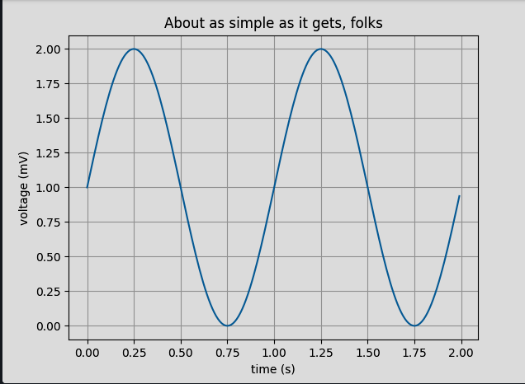
Line Plots
import matplotlib.pyplot as plt
import numpy as np
# Data for plotting
t = np.arange(0.0, 2.0, 0.01)
s = 1 + np.sin(2 * np.pi * t)
fig, ax = plt.subplots()
ax.plot(t, s)
ax.set(xlabel='time (s)', ylabel='voltage (mV)',
title='About as simple as it gets, folks')
ax.grid()
fig.savefig("test.png")
plt.show()

Slide 7
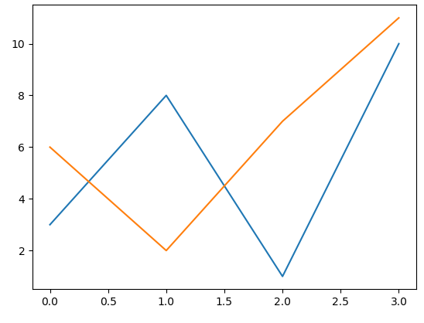
Line Plots
import matplotlib.pyplot as plt
import numpy as np
x1 = np.array([0, 1, 2, 3])
y1 = np.array([3, 8, 1, 10])
x2 = np.array([0, 1, 2, 3])
y2 = np.array([6, 2, 7, 11])
plt.plot(x1, y1, x2, y2)
plt.show()

Slide 8
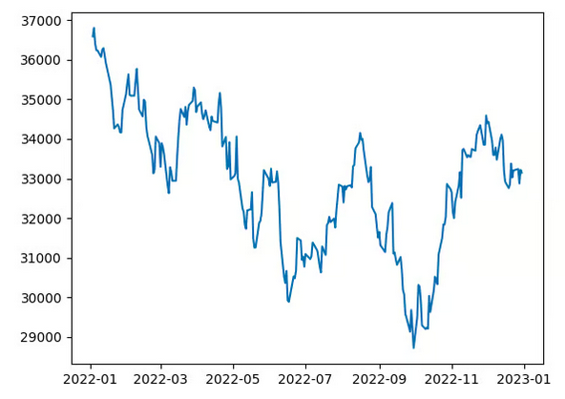
Line Plots
import matplotlib.pyplot as plt
import pandas as pd
# Load the dataset into a Pandas DataFrame
df = pd.read_csv("HistoricalPrices.csv")
# Rename the column to remove an additional space
df = df.rename(columns = {' Open': 'Open', ' High': 'High', ' Low': 'Low', ' Close': 'Close'})
# Convert the date column to datetime
df['Date'] = pd.to_datetime(df['Date'])
# Sort the dataset in the ascending order of date
df = df.sort_values(by = 'Date')
# Extract the date and close price columns
dates = df['Date']
closing_price = df['Close']
# Create a line plot
plt.plot(dates, closing_price)
plt.show()

Slide 9
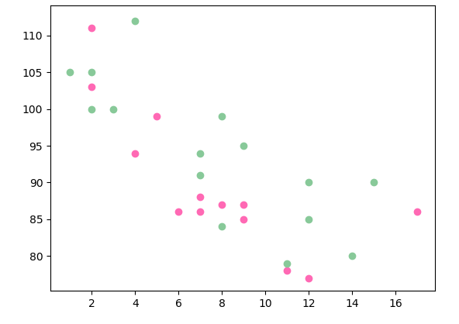
Scatter Plots
import matplotlib.pyplot as plt
import numpy as np
x = np.array([5,7,8,7,2,17,2,9,4,11,12,9,6])
y = np.array([99,86,87,88,111,86,103,87,94,78,77,85,86])
plt.scatter(x, y, color = 'hotpink')
x = np.array([2,2,8,1,15,8,12,9,7,3,11,4,7,14,12])
y = np.array([100,105,84,105,90,99,90,95,94,100,79,112,91,80,85])
plt.scatter(x, y, color = '#88c999')
plt.show()

Slide 10
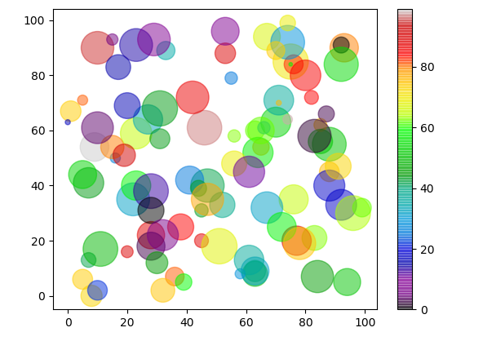
Scatter Plots
import matplotlib.pyplot as plt
import numpy as np
x = np.random.randint(100, size=(100))
y = np.random.randint(100, size=(100))
colors = np.random.randint(100, size=(100))
sizes = 10 * np.random.randint(100, size=(100))
plt.scatter(x, y, c=colors, s=sizes, alpha=0.5, cmap='nipy_spectral')
plt.colorbar()
plt.show()

Slide 11
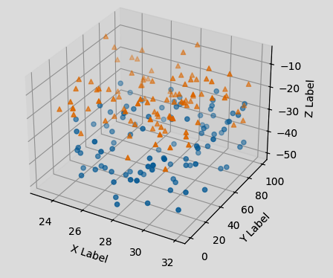
Scatter Plots - 3D
import matplotlib.pyplot as plt
import numpy as np
np.random.seed(19680801) # Fixing random state for reproducibility
def randrange(n, vmin, vmax):
"""
Helper function to make an array of random numbers having shape (n, )
with each number distributed Uniform(vmin, vmax).
"""
return (vmax - vmin)*np.random.rand(n) + vmin
fig = plt.figure()
ax = fig.add_subplot(projection='3d')
n = 100
# For each set of style and range settings, plot n random points in the box
# defined by x in [23, 32], y in [0, 100], z in [zlow, zhigh].
for m, zlow, zhigh in [('o', -50, -25), ('^', -30, -5)]:
xs = randrange(n, 23, 32)
ys = randrange(n, 0, 100)
zs = randrange(n, zlow, zhigh)
ax.scatter(xs, ys, zs, marker=m)
ax.set_xlabel('X Label')
ax.set_ylabel('Y Label')
ax.set_zlabel('Z Label')
plt.show()

Slide 12
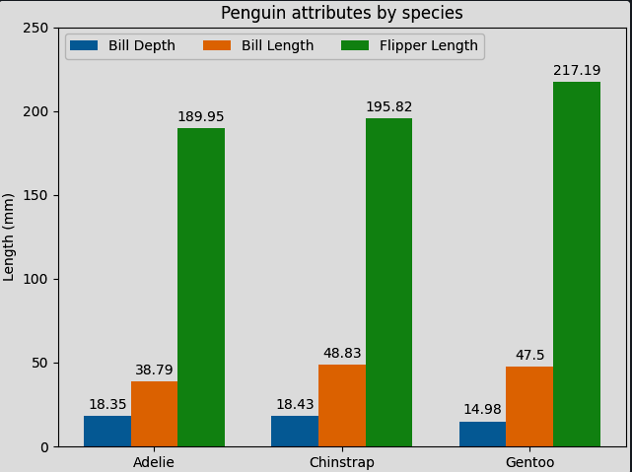
Bar Charts
import matplotlib.pyplot as plt
import numpy as np
species = ("Adelie", "Chinstrap", "Gentoo")
penguin_means = {
'Bill Depth': (18.35, 18.43, 14.98),
'Bill Length': (38.79, 48.83, 47.50),
'Flipper Length': (189.95, 195.82, 217.19),
}
x = np.arange(len(species)) # the label locations
width = 0.25 # the width of the bars
multiplier = 0
fig, ax = plt.subplots(layout='constrained')
for attribute, measurement in penguin_means.items():
offset = width * multiplier
rects = ax.bar(x + offset, measurement, width, label=attribute)
ax.bar_label(rects, padding=3)
multiplier += 1
# Add some text for labels, title and custom x-axis tick labels, etc.
ax.set_ylabel('Length (mm)')
ax.set_title('Penguin attributes by species')
ax.set_xticks(x + width, species)
ax.legend(loc='upper left', ncols=3)
ax.set_ylim(0, 250)
plt.show()

Slide 13
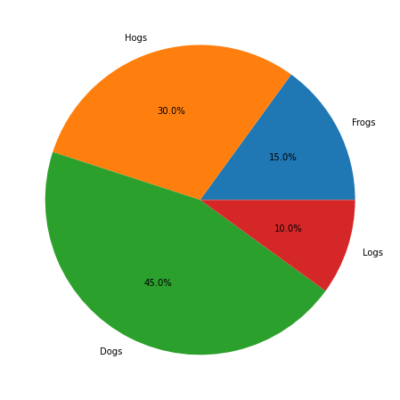
Pie Charts
import matplotlib.pyplot as plt
labels = 'Frogs', 'Hogs', 'Dogs', 'Logs'
sizes = [15, 30, 45, 10]
fig, ax = plt.subplots()
ax.pie(sizes, labels=labels)

Slide 14
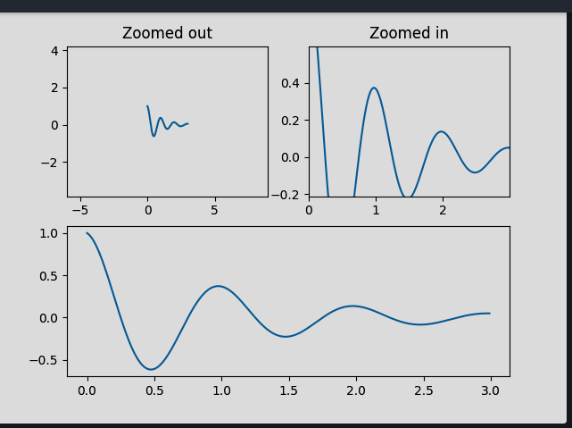
Subplots and Axes
import matplotlib.pyplot as plt
import numpy as np
from matplotlib.patches import Polygon
def f(t):
return np.exp(-t) * np.cos(2*np.pi*t)
t1 = np.arange(0.0, 3.0, 0.01)
ax1 = plt.subplot(212)
ax1.margins(0.05) # Default margin is 0.05, value 0 means fit
ax1.plot(t1, f(t1))
ax2 = plt.subplot(221)
ax2.margins(2, 2) # Values >0.0 zoom out
ax2.plot(t1, f(t1))
ax2.set_title('Zoomed out')
ax3 = plt.subplot(222)
ax3.margins(x=0, y=-0.25) # Values in (-0.5, 0.0) zooms in to center
ax3.plot(t1, f(t1))
ax3.set_title('Zoomed in')
plt.show()

Slide 15
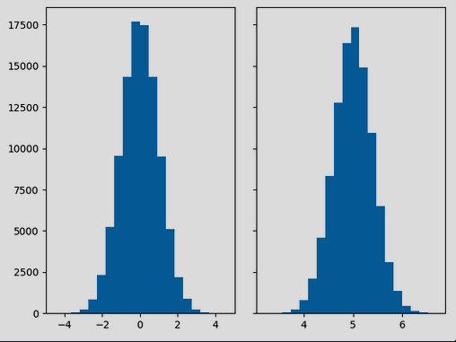
Histogram
import matplotlib.pyplot as plt
import numpy as np
from matplotlib import colors
from matplotlib.ticker import PercentFormatter
# Create a random number generator with a fixed seed for reproducibility
rng = np.random.default_rng(19680801)
N_points = 100000
n_bins = 20
# Generate two normal distributions
dist1 = rng.standard_normal(N_points)
dist2 = 0.4 * rng.standard_normal(N_points) + 5
fig, axs = plt.subplots(1, 2, sharey=True, tight_layout=True)
# We can set the number of bins with the *bins* keyword argument.
axs[0].hist(dist1, bins=n_bins)
axs[1].hist(dist2, bins=n_bins)
plt.show()

Slide 16
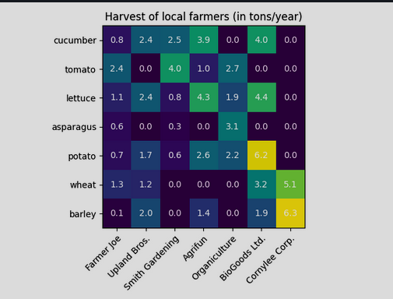
Heatmaps
import matplotlib.pyplot as plt
import numpy as np
import matplotlib
import matplotlib as mpl
vegetables = ["cucumber", "tomato", "lettuce", "asparagus",
"potato", "wheat", "barley"]
farmers = ["Farmer Joe", "Upland Bros.", "Smith Gardening",
"Agrifun", "Organiculture", "BioGoods Ltd.", "Cornylee Corp."]
harvest = np.array([[0.8, 2.4, 2.5, 3.9, 0.0, 4.0, 0.0],
[2.4, 0.0, 4.0, 1.0, 2.7, 0.0, 0.0],
[1.1, 2.4, 0.8, 4.3, 1.9, 4.4, 0.0],
[0.6, 0.0, 0.3, 0.0, 3.1, 0.0, 0.0],
[0.7, 1.7, 0.6, 2.6, 2.2, 6.2, 0.0],
[1.3, 1.2, 0.0, 0.0, 0.0, 3.2, 5.1],
[0.1, 2.0, 0.0, 1.4, 0.0, 1.9, 6.3]])
fig, ax = plt.subplots()
im = ax.imshow(harvest)
# Show all ticks and label them with the respective list entries
ax.set_xticks(range(len(farmers)), labels=farmers,
rotation=45, ha="right", rotation_mode="anchor")
ax.set_yticks(range(len(vegetables)), labels=vegetables)
# Loop over data dimensions and create text annotations.
for i in range(len(vegetables)):
for j in range(len(farmers)):
text = ax.text(j, i, harvest[i, j],
ha="center", va="center", color="w")
ax.set_title("Harvest of local farmers (in tons/year)")
fig.tight_layout()
plt.show()

